Slide 1
Trees 1
-Priyansh Agarwal

Slide 2
What is a Tree
A connected graph of N nodes without any cycles.
What is a graph?
Imagine it like the Earth
Contains a bunch of countries connected via roads
A continent is a group of countries directly or indirectly connected to each other
Some countries might be in different continents -> disconnected
A tree is one such continent with a unique path b/w any 2 countries

Slide 3
What is a Tree
Differentiate b/w a Tree and a Graph from examples
One Note Illustrations
Some Common Terms
Neighbour
Degree
Leaf and non-leaf Nodes (aka Internal Nodes)
Diameter (can be non-unique)

Slide 4
Properties 1
Number of Edges in a Tree for N nodes
N - 1
Number of paths between 2 nodes
1
Sum of Degree of all nodes
2 * (N - 1)
Can there be less than 2 leaf nodes in a Tree with >= 2 nodes
No, except for the case when there is just one node in the entire tree

Slide 5
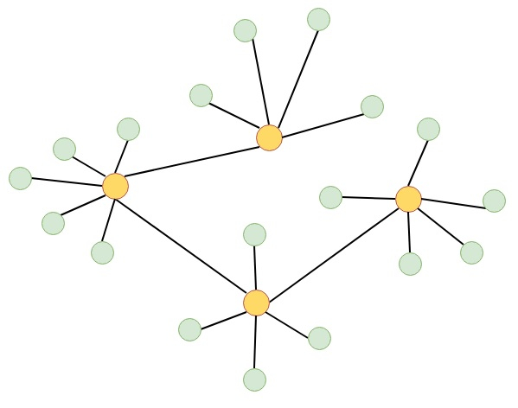
Rooted and Unrooted Trees
Unrooted

Slide 6
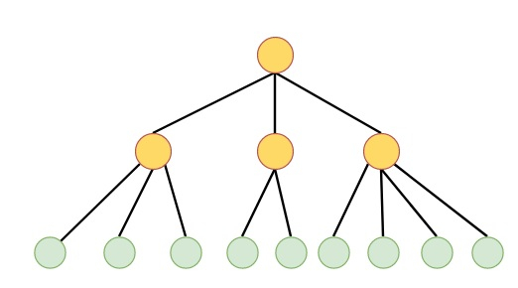
Rooted and Unrooted Trees
Rooted

Slide 7
Some more terms
Root
Parent
Child
Ancestor
Descendant
Level of Node
Subtree
Subtree Size
Height of Tree
Lowest Common Ancestor
-

Slide 8
Properties 2
Can there be more than 2 parents of a single node in a rooted tree
No
Path property. What are the only 3 types of paths possible?
1. Go Up, Come Down 2. Go Up 3. Come Down
How to color a Tree with just 2 colors such that no two neighbours have the same color
Just root the tree and color level wise
Bonus Tip:
Most Codeforces problems less than 1800 rated on Codeforces can be easily solved if you just remember the basic properties and learn to apply them.

Slide 9
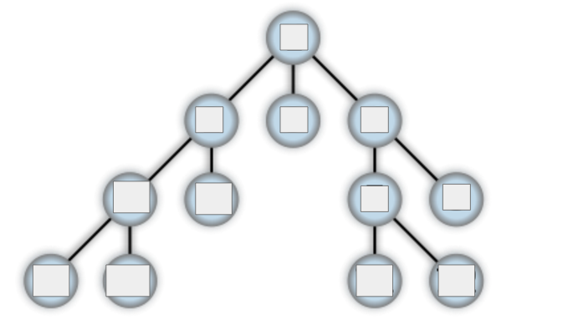
Traversals in a Tree
How to traverse the tree in a way such that we visit all nodes

Slide 10
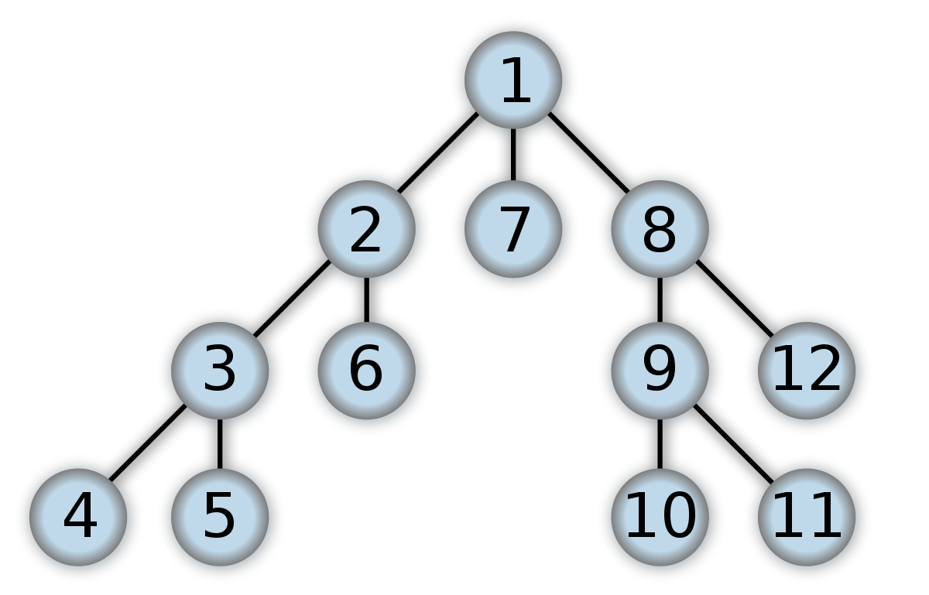
DFS Traversal in a Tree
Nodes are numbered in the order in which they are visited

Slide 11
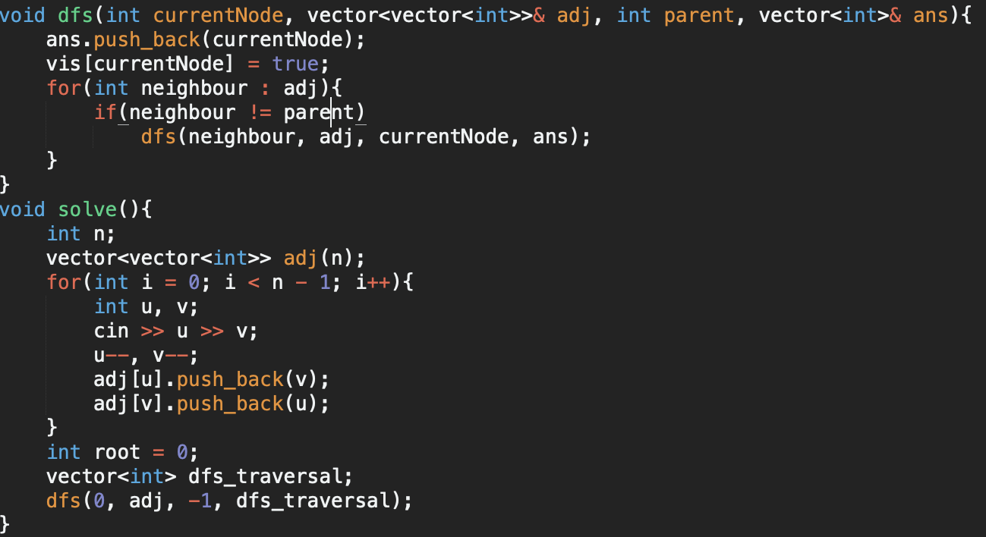
DFS Traversal in a Tree
Implementation:
Time Complexity: O(N)

Slide 12
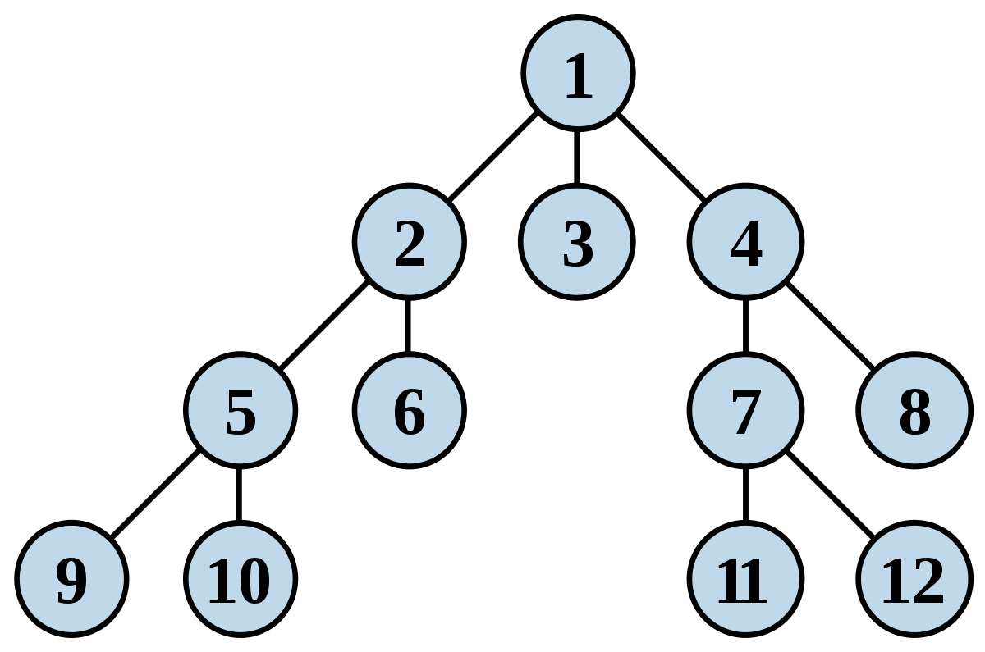
BFS Traversal in a Tree
Nodes are numbered in the order in which they are visited

Slide 13
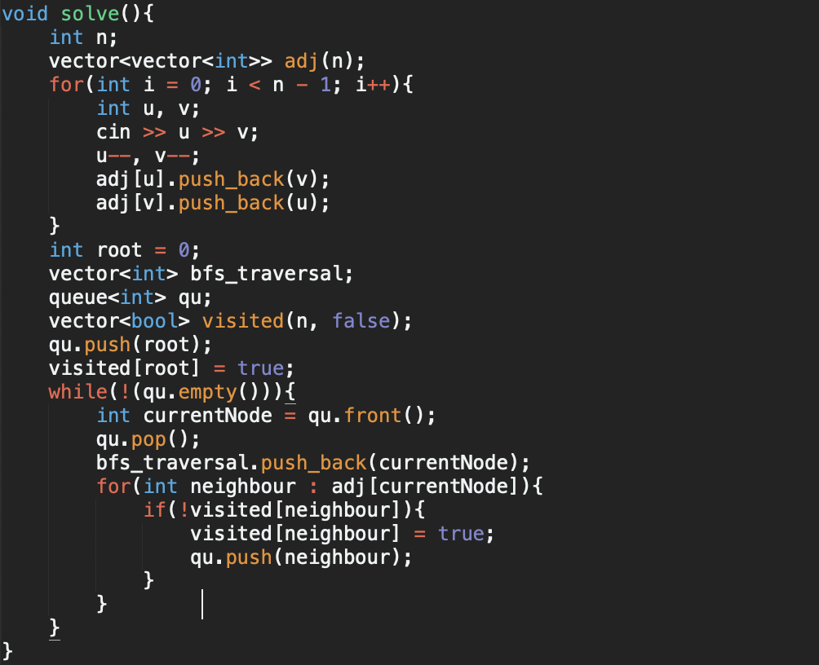
BFS Traversal in a Tree
Implementation:
Time Complexity: O(N)

Slide 14
Problems on Traversals
Level of each node

Slide 15
Problems on Traversals
Storing the parent of each node

Slide 16
Problems on Traversals
Finding the number of children of each node

Slide 17
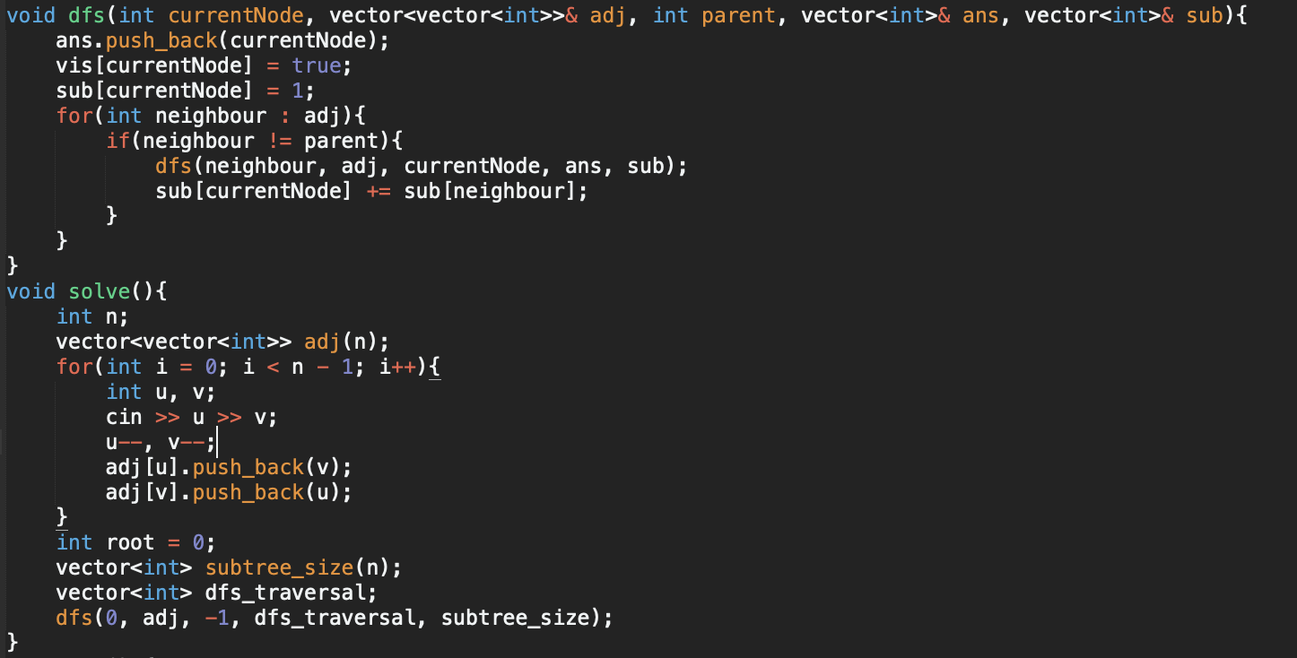
Problems on Traversals
Finding subtree size of each node

Slide 18
Ancestor - Descendant Problem
Given a rooted tree with N nodes and Q queries.
For each query of the form X, Y check whether X is an ancestor of Y or not
N <= 1e5, Q <= 1e5

Slide 19
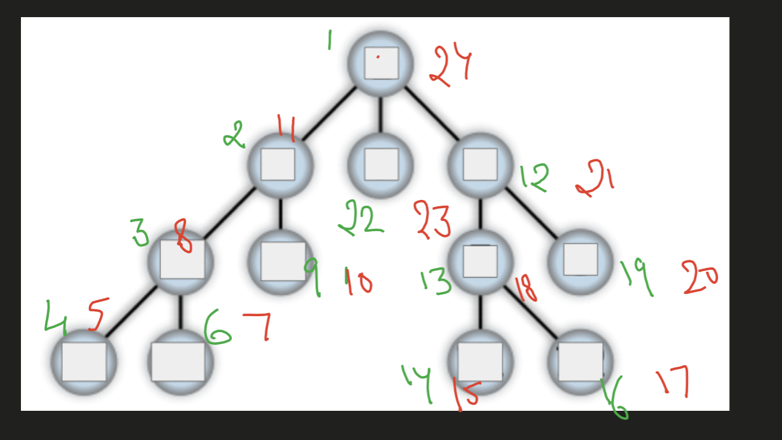
In - Out Time trick
Do a DFS traversal.
Store the following information for each node:
First visited time = In time
Last visited time = out time
Can you solve the ancestor descendant problem now?

Slide 20
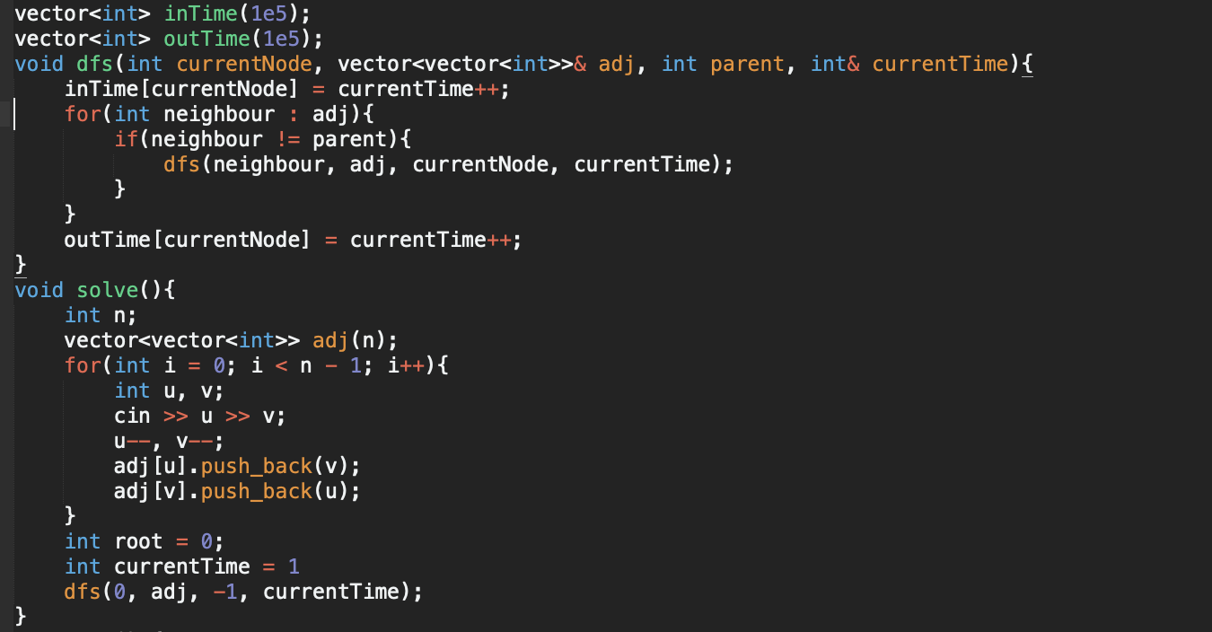
In - Out Time trick

Slide 21
In - Out Time trick
Solving the ancestor - descendant problem:
If X is an ancestor of Y
X_{in time} < Y_{in time} < Y_{out time} < X_{out time}

Slide 22
Distance b/w 2 nodes Problem
Given a rooted tree with N nodes and Q queries.
For each query of the form X, Y find distance from X to Y
N <= 1e5, Q <= 1e5

Slide 23
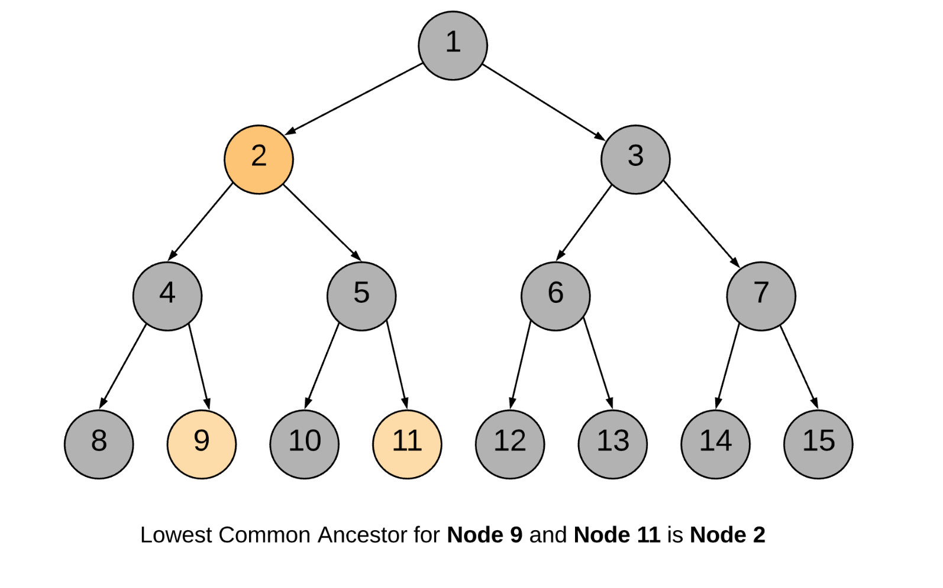
LCA Property in Paths
dist(A, B) = level_{A} + Level_{B} - 2 * Level_{LCA}

Slide 24
Practice Problems
Spruce (Easy)
Useful Decomposition (Easy)
Kefa and Park (Medium)
Tree Coloring (Medium)

